Slide 1
DNA Replication: An Overview

Slide 2
Different models for DNA replication

Slide 3
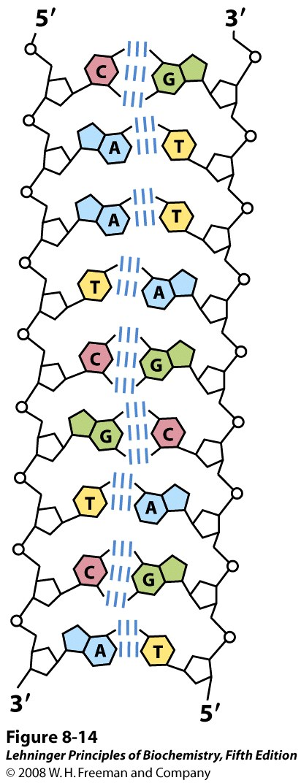
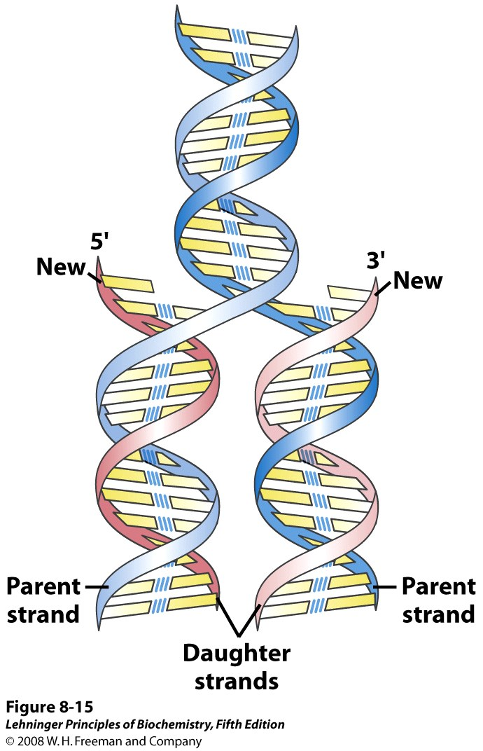
Semiconservative Replication of DNA as suggested by Watson and Crick
Notes:
Replication of DNA as suggested by Watson and Crick. The pre-existing or "parent" strands become separated, and each is the template for biosynthesis of a complementary "daughter" strand (in pink).

Slide 4
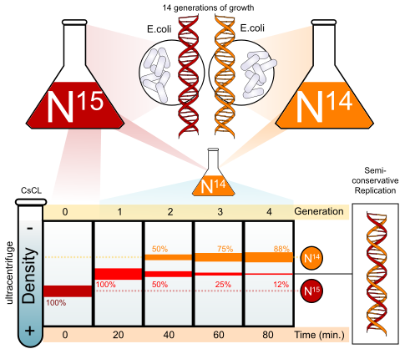
The Meselson-Stahl Experiment (1958)
Notes:
Semiconservative replication means that the daughter DNA has one newly synthesized strand and one old strand that served as the template.

Slide 5
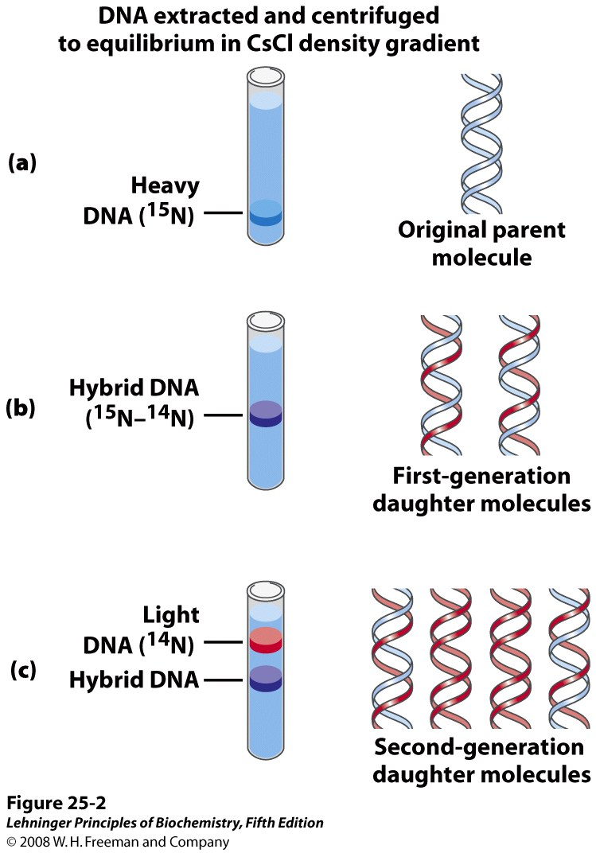
The Meselson-Stahl Experiment Supports Semiconservative Replication
Notes:
The Meselson-Stahl experiment. (a) Cells were grown for many generations in a medium containing only heavy nitrogen, ¹⁵N, so that all the nitrogen in their DNA was ¹⁵N, as shown by a single band (blue) when centrifuged in a CsCl density gradient. (b) Once the cells had been transferred to a medium containing only light nitrogen, ¹⁴N, cellular DNA isolated after one generation equilibrated at a higher position in the density gradient (purple band). (c) A second cycle of replication yielded a hybrid DNA band (purple) and another band (red), containing only [¹⁴N]DNA, confirming semiconservative replication.

Slide 6
Meselson and Stahl grew a culture of E.coli for many generations in a medium that contained ¹⁵N as the sole nitrogen source. (¹⁵NH4Cl).
After many generations, all the E.coli cells had ¹⁵N incorporated into the purine and pyrimidine bases of their DNA.
Meselson and Stahl took a sample of these bacteria and switched the rest of the bacteria to a medium that contained only ¹⁴N (washed them before transferring to remove the medium containing ¹⁵N).
They purified the DNA sample collected from the bacteria just before transfer to the ¹⁴N containing medium.
Meselson and Stahl collected some of the bacteria after each division and extracted DNA from the bacterial cells (Collected samples of bacteria over the next few cellular generations).
Under the conditions they used, E.coli replicates its DNA every 20 minutes. They took samples at an interval of 20 minutes.
After extracting DNA from bacteria they checked for the density of DNA

Slide 7
Outline for Replication
A. Initiation
B. Priming
C. Elongation
D. Proofreading and Termination

Slide 8
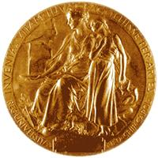
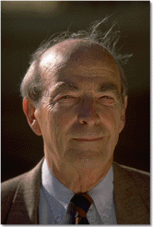
Arthur Kornberg
Nobel Prize in 1959
Worked with E. coli. Discovered the mechanisms of
DNA synthesis in 1956.
Four components are required:
dNTPs: dATP, dTTP, dGTP, dCTP
(deoxyribonucleoside 5’-triphosphates)
(sugar-base + 3 phosphates)
2. DNA template
DNA polymerase (Kornberg enzyme)
4. Mg²⁺ (optimizes DNA polymerase activity)

Slide 9
Polymerization of nucleotide triphosphates by DNA polymerase – needs free 3’OH
OH
OH

Slide 10
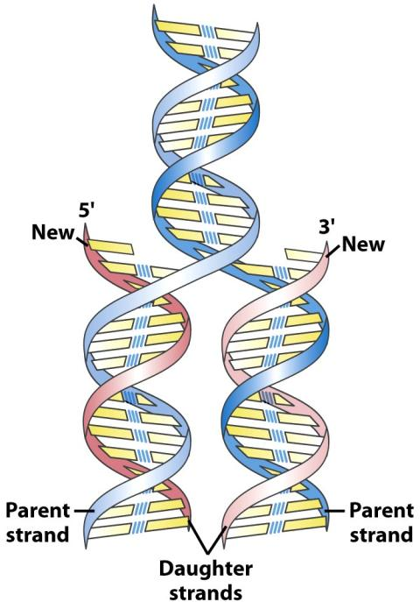
Problem -1
DNA is double helical. Hence the two strands have to be separated from each other

Slide 11
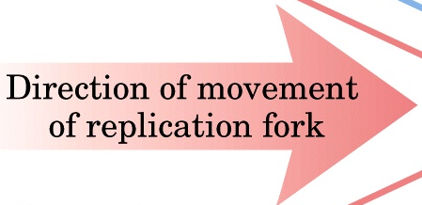
Problem - 1 : DNA unwinding
DNA is unwound by helicase, stabilized by SSB proteins; supercoiling is relaxed by Topoisomerase
5’
SSB (single strand binding) Proteins
ATP
ADP
Helicase
Helicase
3’
3’
5’
5’
Topoisomerase
3’

Slide 12
Problem - 2
DNA polymerase needs a free 3’-OH of a pre-existing nucleotide to extend the chain
OH
OH

Slide 13
Problem – 2 : Free 3’ OH group required
Primase synthesizes small RNA primers,
DNA Polymerase III extends them
5’
SSB (single strand binding) Proteins
Okazaki Fragments
1
ATP
Polymerase III
2
Lagging strand
3
Helicase
+
Initiator Proteins
3’
5’
Leading strand
Polymerase III
5’ → 3’
RNA Primer
primase
3’
Notes:
Helicase unwinds the double helix in advance of the replication fork. DNA polymerase III can only extend a pre-existing strand. Hence, a short sequence (RNA primer) is provided by RNA polymerase, which is extended by the DNA polymerase III. Later on, this RNA primer is replaced by polymerase I, which put DNA. Finally, ligase joins the fragments.
DNA polymerase III can extend a strand only in the 5’ to 3’ direction. Hence, the lagging strand is synthesized discontinuously as more and more DNA is unwound by the helicase. The fragments on the lagging strand are called Okazaki fragments.

Slide 14
Problem -3 : RNA primers need to be removed
RNA primers are replaced with DNA by DNA Polymerase I, which has both RNaseH and DNA Polymerase activity. The gaps are sealed by Ligase
5’
SSB (single strand binding) Proteins
Okazaki Fragments
1
ATP
Polymerase III
2
Lagging strand
Helicase
+
Initiator Proteins
3
3’
5’
Leading strand
RNA primer replaced by polymerase I (inherent RNaseH)
Polymerase III
5’ → 3’
RNA Primer
Gaps are sealed by ligase
3’
Notes:
Helicase unwinds the double helix in advance of the replication fork. DNA polymerase III can only extend a pre-existing strand. Hence, a short sequence (RNA primer) is provided by RNA polymerase, which is extended by the DNA polymerase III. Later on, this RNA primer is replaced by polymerase I, which put DNA. Finally, ligase joins the fragments.
DNA polymerase III can extend a strand only in the 5’ to 3’ direction. Hence, the lagging strand is synthesized discontinuously as more and more DNA is unwound by the helicase. The fragments on the lagging strand are called Okazaki fragments.

Slide 15
DNA Replication: Summary
DNA is unwound by initiator protein + helicase
Single stranded DNA is stabilized by single stranded DNA binding proteins (SSB)
Supercoiling is relaxed by Topoisomerase
Small RNA primers are added by Primase (RNA polymerase)
DNA Polymerase III extends from 3’ ends of primer sequences
DNA Polymerase can only extend from pre-existing 3’OH group
Hence synthesis is always from 5’-3’ direction
It needs DNA template, dNTPs and Mg²⁺ ions
Replication is continuous in leading strand and discontinuous in lagging strands. Small newly synthesized DNA fragments in lagging strand are called Okazaki fragments
RNA primers are replaced with DNA by DNA Polymerase I, which has both RNaseH and DNA Polymerase activity
The gaps are sealed by Ligase

Slide 16
Laboratory methods for nucleic acid analysis

Slide 17
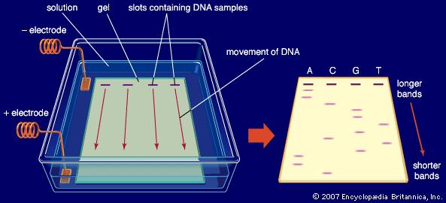
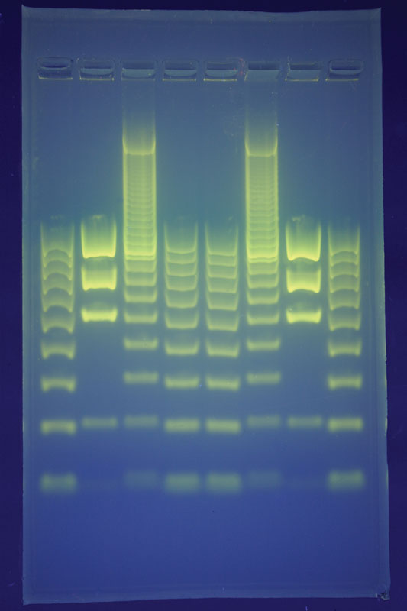
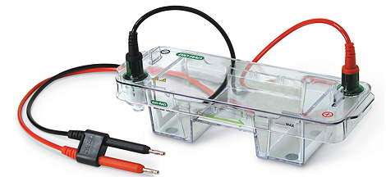
DNA Gel Electrophoresis

Slide 18
DNA Gel Electrophoresis
Agarose gel is used to analyze a mixture of DNA.
DNA is negatively charged and hence migrates towards the positive terminal in the applied electric field gradient.
Different DNA molecules separate according to mass.
Smaller molecules migrate faster.
DNA is visualized in the gel by staining with ethidium bromide, which fluoresces under UV light.
UV light at 302 nm or 365 nm wavelengths are used.

Slide 19
Polymerase Chain Reaction (PCR) and Its Applications

Slide 20
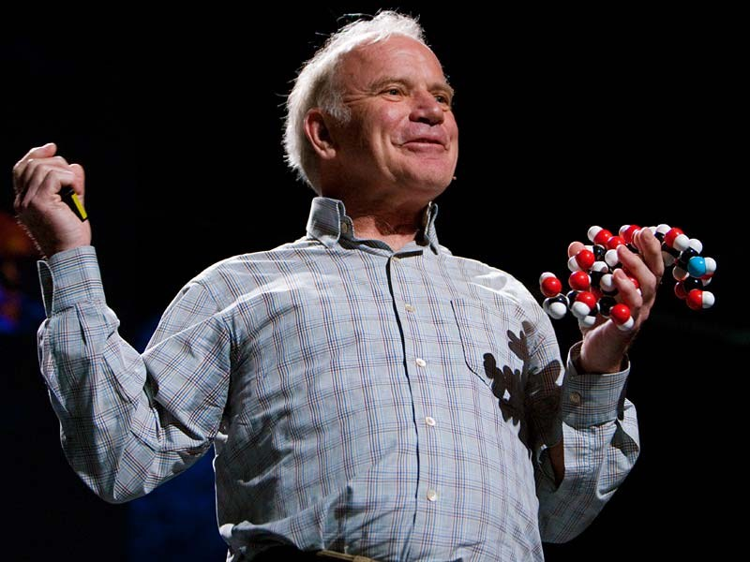
What is PCR?
PCR is an exponentially progressing synthesis of the defined target DNA sequences in vitro.
It was invented in 1983 by Dr. Kary Mullis
Nobel Prize in 1993

Slide 21
Polymerase Chain Reaction (PCR) Why “Polymerase” ?
It is called “polymerase” because the only enzyme used in this reaction is DNA polymerase.
Why “Chain” ?
It is called “chain” because the products of the first reaction become substrates of the following one, and so on.

Slide 22
The “Reaction” Components
Polymerase Chain Reaction (PCR)
1) Target DNA - contains the sequence to be amplified.
2) Pair of Primers - oligonucleotides that define the sequence to be amplified.
3) dNTPs - deoxynucleotidetriphosphates: DNA building blocks.
4) Thermostable DNA Polymerase - enzyme that catalyzes the reaction
5) Mg⁺⁺ ions - cofactor of the enzyme
6) Buffer solution - maintains pH and ionic strength of the reaction solution suitable for the activity of the enzyme

Slide 23
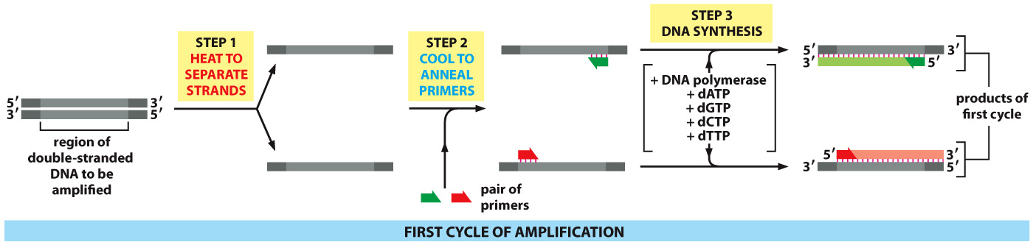
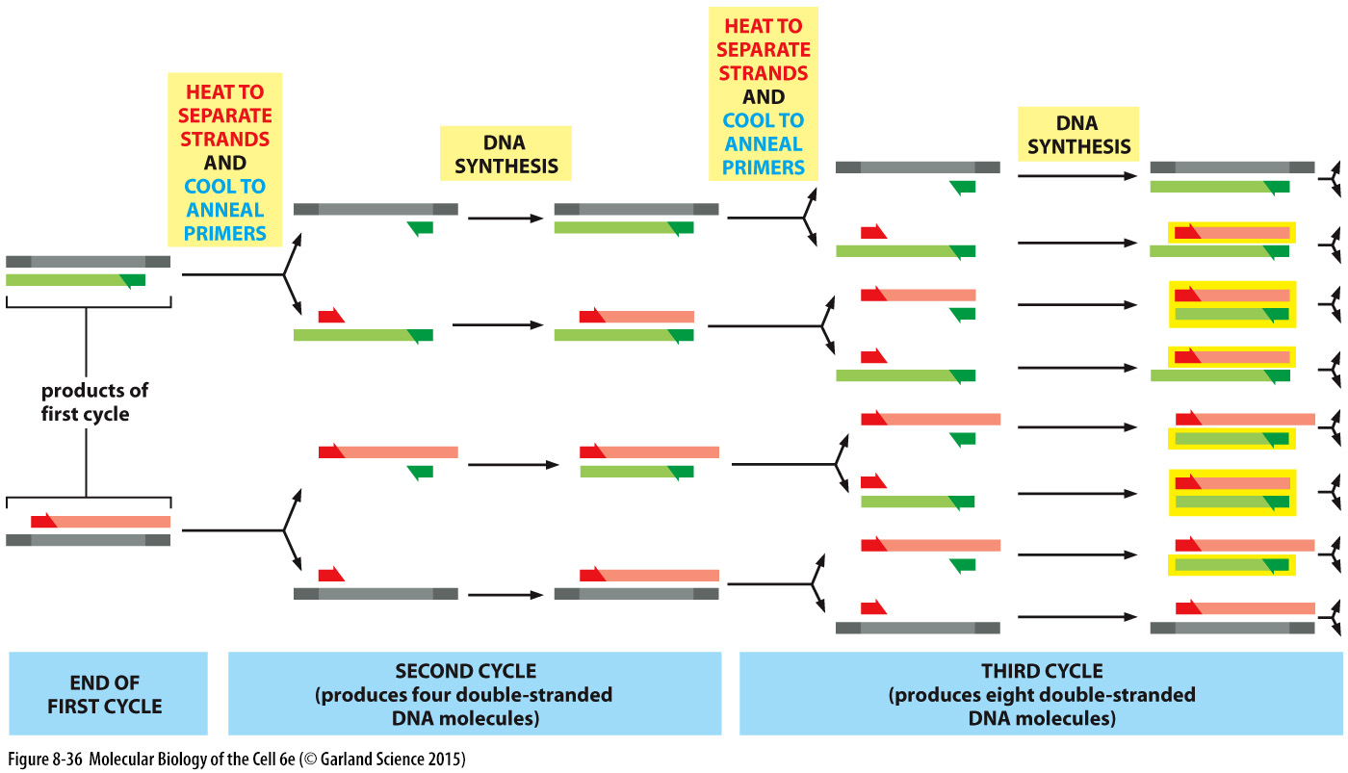

Slide 24
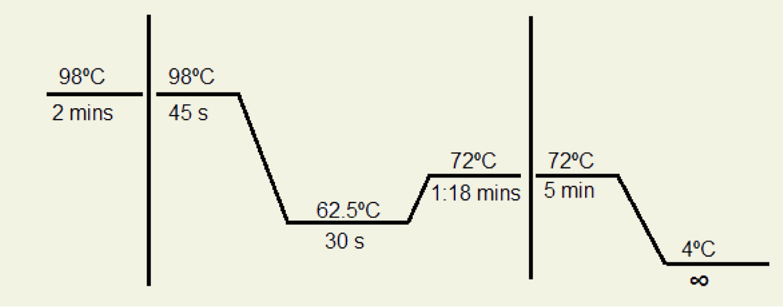
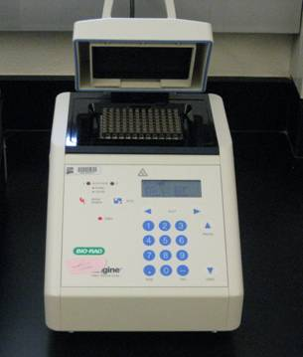
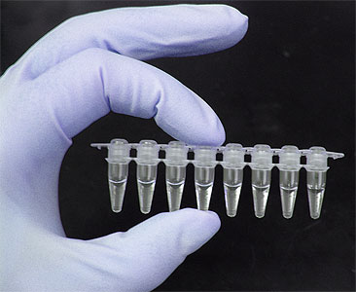
Reaction Cycle and the Machine
Step-1
Step-2 (x 20-35)
Step-3
Temperature
Time
30 cycles = 2³⁰ i.e. 1,073,741,824 copies
PCR tube
Thermocycler

Slide 25
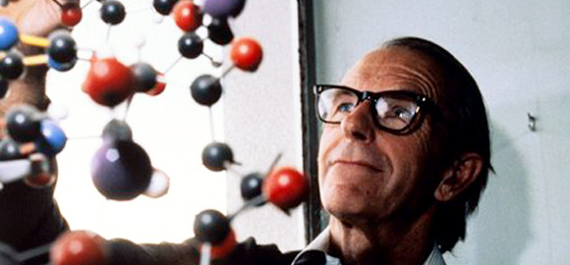
DNA Sequencing
Frederick Sanger
Nobel Prize in 1980
Sequencing: The process by which you determine the exact order of the nucleotides in a given region of DNA
Why? To decode the genetic information embedded in DNA
How? Through complementary chain synthesis and early termination
The synthesized chains are visualized by methods using:
Radioactive labels
Nonradioactive labels

Slide 26
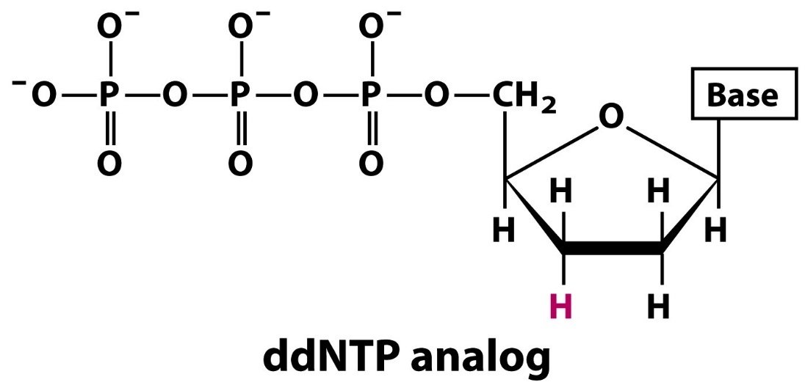
Dideoxynucleotides (ddNTPs)
OH
dNTP
The 3’ hydroxyl has been changed to a hydrogen in ddNTP’s, which terminates a DNA chain because a phosphodiester bond cannot form at this 3’ location

Slide 27
Requirements for Sanger-Coulson Sequencing
DNA to be sequenced must be in single strand form
The region to be sequenced must be flanked by a stretch of 3’ known sequence
Reagents needed are:
A primer complementary to the known region to direct chain synthesis.
DNA polymerase.
4 deoxynucleotide triphosphates (dNTPs).
4 dideoxynucleotide triphosphates (ddNTPs)
(one for each set)

Slide 28

Mechanism of DNA polymerization
OH
OH
Since the 3’ –OH is changed to a –H in ddNTPs, it is unable to form a phosphodiester bond by nucleophilic attack on the phosphate, and it will cause a termination in the DNA chain

Slide 29
Sequencing using denaturing gel-electrophoresis
Primer
Template
3’ – A T A T C T G T A C C T A G G T G A G T C A G T A C C -5’
5’ – T A T A G A C
5’ – T A T A G A C A
5’ – T A T A G A C A T G G A
5’ – T A T A G A C A T G G A T C C A
5’ – T A T A G A C A T G G A T C C A C T C A
5’ – T A T A G A C A T G G A T C C A C T C A G T C A
Differentially elongated fragments
To each reaction along with the four regular dNTPs, only one of the four dideoxynucleotides (ddATP in the above reaction) are added
The ddNTP is added to be approximately 100-fold lower in concentration than the corresponding dNTP
A series of differentially elongated DNA fragments (hence of different length) will be produced
Can be visualized by labelling the primers with radioactive phosphate (³²P or ³³P)

Slide 30
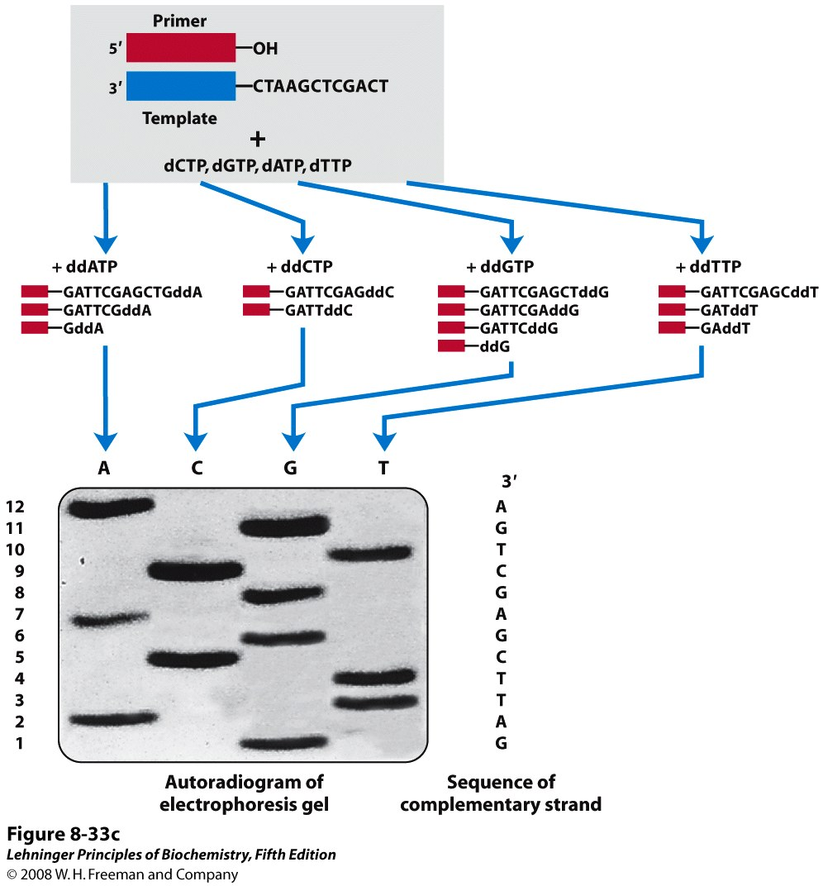
Sequencing using denaturing gel-electrophoresis
Notes:
FIGURE 8-33c DNA sequencing by the Sanger method. This method makes use of the mechanism of DNA synthesis by DNA polymerases (Chapter 25). (c) The DNA to be sequenced is used as the template strand, and a short primer, radioactively or fluorescently labeled, is annealed to it. By addition of small amounts of a single ddNTP, for example ddCTP, to an otherwise normal reaction system, the synthesized strands will be prematurely terminated at some locations where dC normally occurs. Given the excess of dCTP over ddCTP, the chance that the analog will be incorporated whenever a dC is to be added is small. However, ddCTP is present in sufficient amounts to ensure that each new strand has a high probability of acquiring at least one ddC at some point during synthesis. The result is a solution containing a mixture of labeled fragments, each ending with a C residue. Each C residue in the sequence generates a set of fragments of a particular length, such that the different-sized fragments, separated by electrophoresis, reveal the location of C residues. This procedure is repeated separately for each of the four ddNTPs, and the sequence can be read directly from an autoradiogram of the gel. Because shorter DNA fragments migrate faster, the fragments near the bottom of the gel represent the nucleotide positions closest to the primer (the 5′ end), and the sequence is read (in the 5′→3′ direction) from bottom to top. Note that the sequence obtained is that of the strand complementary to the strand being analyzed.

Slide 31
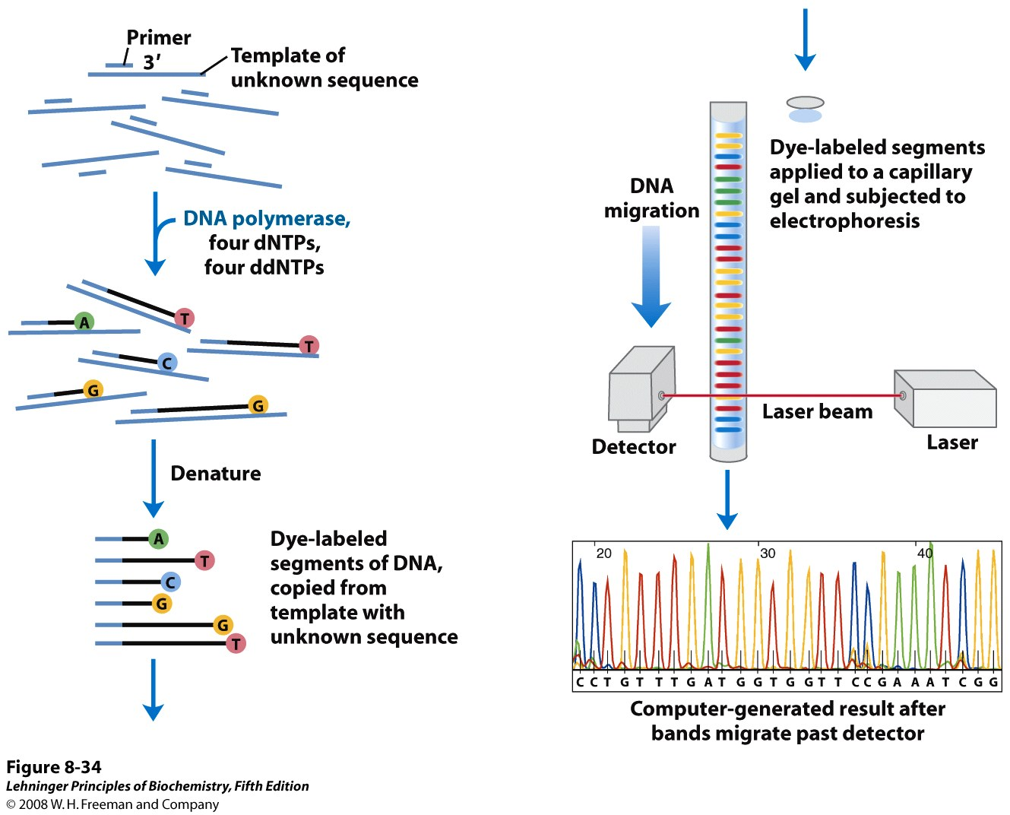
Automated sequencing
Notes:
FIGURE 8-34 Strategy for automating DNA sequencing reactions. Each dideoxynucleotide used in the Sanger method can be linked to a fluorescent molecule that gives all the fragments terminating in that nucleotide a particular color. All four labeled ddNTPs are added to a single tube. The resulting colored DNA fragments are then separated by size in a single electrophoretic gel contained in a capillary tube (a refinement of gel electrophoresis that allows for faster separations). All fragments of a given length migrate through the capillary gel in a single peak, and the color associated with each peak is detected using a laser beam. The DNA sequence is read by determining the sequence of colors in the peaks as they pass the detector. This information is fed directly to a computer, which determines the sequence.

Slide 32
Automated sequencing
Each dideoxynucleotide used are linked to a fluorescent molecule that gives all the fragments terminating in that nucleotide a particular color.
All four labelled ddNTPs are added to a single tube.
The resulting colored DNA fragments are then separated by capillary gel electrophoresis
The color associated with each peak is detected using a laser beam.
The DNA sequence is read by determining the sequence of colors in the peaks as they pass the detector.
This information is fed directly to a computer, which determines the sequence.

Slide 33
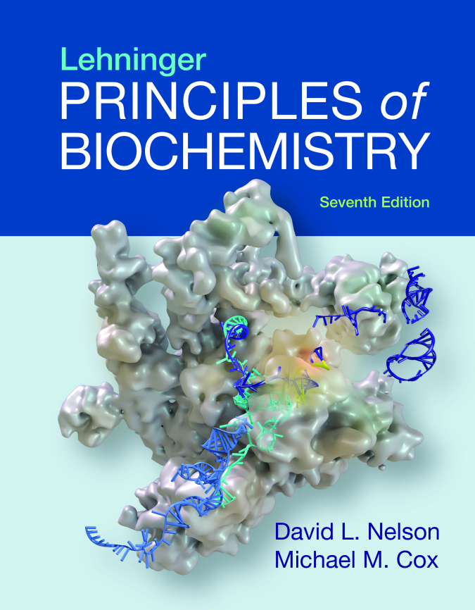
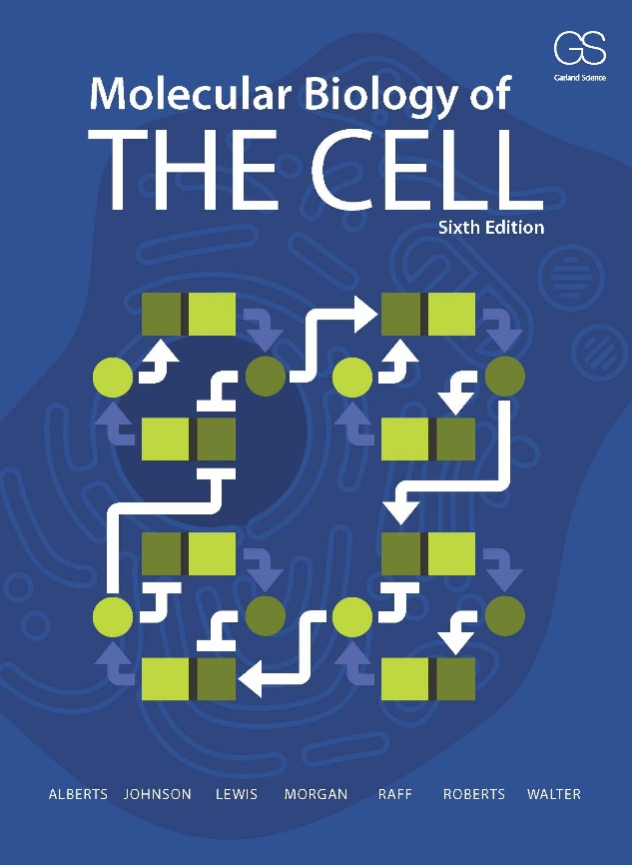
References

Slide 34
Extra resources
Book:
The Double Helix: A Personal Account of the Discovery of the Structure of DNA - By James D Watson
Videos:
DNA replication
https://www.youtube.com/watch?v=TNKWgcFPHqw
DNA sequencing:
https://www.youtube.com/watch?v=vK-HlMaitnE
Polymerase Chain Reaction (PCR)
http://video.mit.edu/watch/pcr-polymerase-chain-reaction-10948/
https://www.dnalc.org/view/15475-The-cycles-of-the-polymerase-chain-reaction-PCR-3D-animation.html

